Slide 1
CSE 2202 Design and Analysis of Algorithms – I Lecture 4 Topological Sort Strongly Connected Components

Slide 2
DFS Review

Slide 3
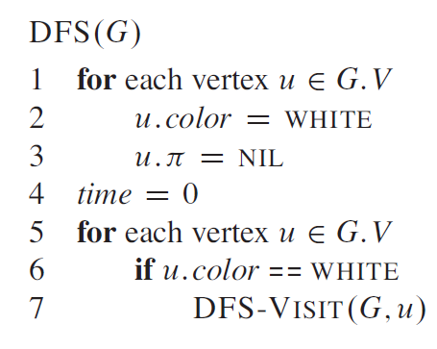
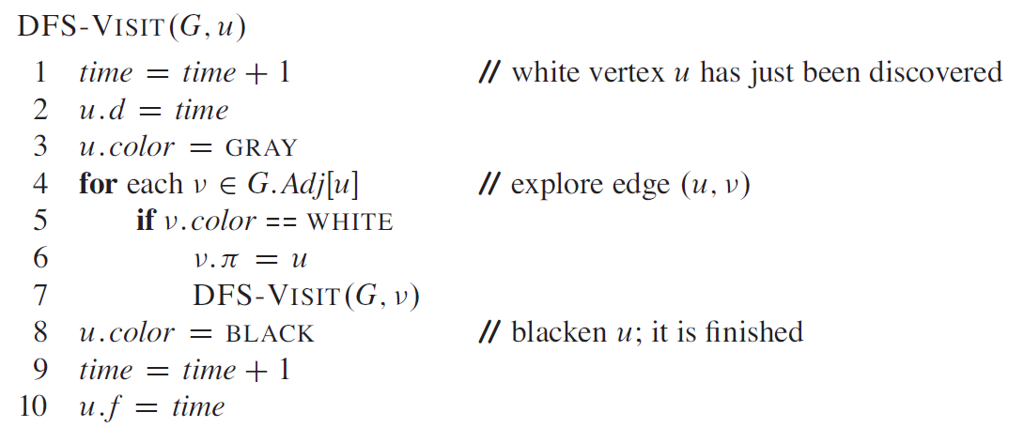
DFS Review

Slide 4
DFS Review
Every time DFS-VISIT(G, u) is called, u becomes the root of a new tree in the depth-first forest

Slide 5
DFS Complexity
The first "loop" over all vertices happens because we want to ensure we cover all vertices, including those not reachable from our starting vertex (i.e., if the graph is not connected). This part contributes O(V) to the overall time complexity.
Now, for each vertex, we don't exactly iterate over all vertices. Instead, we iterate over the neighbours of the given vertex. In other words, we iterate over its adjacency list, which basically corresponds to the edges connected to that vertex.
Each edge will be examined exactly twice in an undirected graph: once for each of its endpoints. Therefore, the second "loop" over the adjacency lists for each vertex contributes O(2E) = O(E) to the time complexity.
So, when we sum the two parts, we get O(V + E).

Slide 6
Example
u
v
w
u
v
w
u
v
w
1/
1/
2/
1/
2/
3/
x
y
z
x
y
z
x
y
z
u
v
w
u
v
w
u
v
w
1/
2/
1/
2/
1/
2/
B
B
4/
3/
4/
3/
4/5
3/
x
y
z
x
y
z
x
y
z
u
v
w
u
v
w
u
v
w
1/
2/
1/
2/7
1/
2/7
B
B
F
B
4/5
3/6
4/5
3/6
4/5
3/6
x
y
z
x
y
z
x
y
z

Slide 7
Example (cont.)
u
v
w
u
v
w
u
v
w
1/8
2/7
1/8
2/7
9/
1/8
2/7
9/
B
B
C
F
B
F
F
4/5
3/6
4/5
3/6
4/5
3/6
x
y
z
x
y
z
x
y
z
u
v
w
u
v
w
u
v
w
1/8
2/7
9/
1/8
2/7
9/
1/8
2/7
9/
B
C
B
C
B
C
F
F
B
F
B
4/5
3/6
10/
4/5
3/6
10/
4/5
3/6
10/11
x
y
z
x
y
z
x
y
z
u
v
w
The results of DFS may depend on:
The order in which nodes are explored in procedure DFS
The order in which the neighbors of a vertex are visited in DFS-VISIT
1/8
2/7
9/12
B
C
F
B
4/5
3/6
10/11
x
y
z

Slide 8
Edge Classification
Tree edge (reaches a WHITE vertex):
(u, v) is a tree edge if v was first discovered by exploring edge (u, v)
Back edge (reaches a GRAY vertex):
(u, v), connecting a vertex u to an ancestor v in a depth first tree
Self loops (in directed graphs) are also back edges
u
v
w
1/
x
y
z
u
v
w
1/
2/
B
4/
3/
x
y
z

Slide 9
Edge Classification
Forward edge (reaches a BLACK vertex & d[u] < d[v]): (here d[u] is the same as u.d)
Non-tree edges (u, v) that connect a vertex u to a descendant v in a depth first tree
Cross edge (reaches a BLACK vertex & d[u] > d[v]):
Can go between vertices in same depth-first tree (as long as there is no ancestor / descendant relation) or between different depth-first trees
u
v
w
1/
2/7
F
B
4/5
3/6
x
y
z
u
v
w
1/8
2/7
9/
B
C
F
4/5
3/6
x
y
z

Slide 10
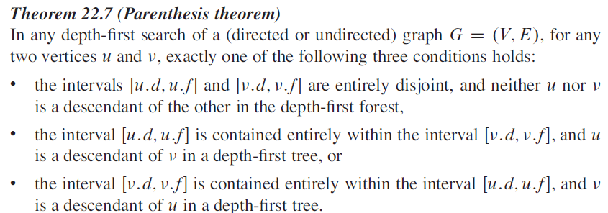
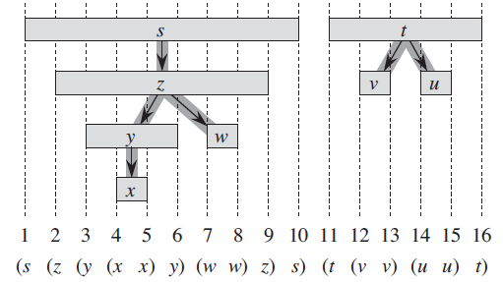
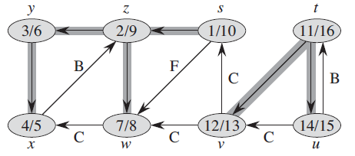
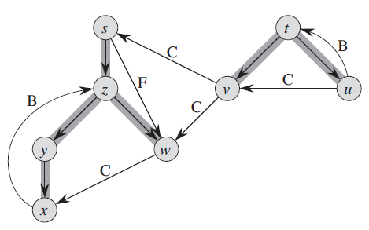
Well-formed expression: parenthesis are
properly nested

Slide 11
Characterizing a DAG
Lemma 22.11
A directed graph G is acyclic iff a DFS of G yields no back edges.
T
T
T
v
u
B

Slide 12
Topological sort

Slide 13

Topological Sort
Topological sort of a directed acyclic graph
G = (V, E): a linear order of vertices such that if there exists an edge (u, v), then u appears before v in the ordering.
Used to represent precedence of events or processes that have a partial order
Topological sort helps us establish a total order

Slide 14
Topological Sort
Want to “sort” a directed acyclic graph (DAG).
A
B
D
C
E
A
B
C
D
E
Think of original DAG as a partial order.
Want a total order that extends this partial order.

Slide 15
Topological Sort - Application
Application 1
in scheduling a sequence of jobs.
The jobs are represented by vertices,
there is an edge from x to y if job x must be completed before job y can be done
(for example, washing machine must finish before we put the clothes to dry). Then, a topological sort gives an order in which to perform the jobs
Application 2
In open credit system, how to take courses (in order) such that, pre-requisite of courses will not create any problem

Slide 16
Topological Sort (Fig – Cormen)
undershorts
11/
16
17/
18
socks
TOPOLOGICAL-SORT(V, E)
Call DFS(V, E) to compute finishing times f[v] for each vertex v
When each vertex is finished, insert it onto the front of a linked list
Return the linked list of vertices
12/
15
pants
shoes
13/
14
1/
shirt
8
6/
7
belt
watch
9/
10
tie
2/
5
jacket
3/
4
socks
undershorts
pants
shoes
watch
shirt
belt
tie
jacket
Running time: Θ(V + E)

Slide 17
Topological Sort on detection of a cyclic graph?
It's not possible to generate a topological sort for a graph that contains a cycle.
Topological sorting is for Directed Acyclic Graphs (DAGs)
If you attempt a topological sort on a graph with a cycle, your algorithm should detect the cycle and report that a topological sort is not possible.
This can be done, for instance, by maintaining three states for each vertex during a DFS: unvisited, visited but still in recursion stack (i.e., being explored), and completely processed.
If a vertex that's still in the recursion stack is encountered again, that indicates a cycle.

Slide 18
Strongly Connected Component
A classic application of DFS: decomposing a directed graph into its strongly connected components.
We will see how to do so using two depth-first searches.
Many algorithms that work with directed graphs begin with such a decomposition.
After decomposing the graph into strongly connected components
such algorithms run separately on each one and
then combine the solutions according to the structure of connections among components.

Slide 19
Connectivity
Connected Graph
In an undirected graph G, two vertices u and v are called connected if G contains a path from u to v. Otherwise, they are called disconnected.
A directed graph is called connected if every pair of distinct vertices in the graph is connected.
Connected Components
A connected component is a maximal connected subgraph of G. Each vertex belongs to exactly one connected component, as does each edge.

Slide 20
Connectivity (cont.)
Weakly Connected Graph
A directed graph is called weakly connected if replacing all of its directed edges with undirected edges produces a connected (undirected) graph.
Strongly Connected Graph
It is strongly connected or strong if it contains a directed path from u to v for every pair of vertices u, v. The strong components are the maximal strongly connected subgraphs

Slide 21
Connected Components
Strongly connected graph
A directed graph is called strongly connected if for every pair of vertices u and v there is a path from u to v and a path from v to u.
Strongly Connected Components (SCC)
The strongly connected components (SCC) of a directed graph are its maximal strongly connected subgraphs.
Here, we work with
Directed unweighted graph

Slide 22
Strongly Connected Components
G is strongly connected if every pair (u, v) of vertices in G is reachable from one another.
A strongly connected component (SCC) of G is a maximal set of vertices C ⊆ V such that for all u, v ∈ C, both u v and v u exist.

Slide 23
DFS - Strongly Connected Components
A
C
E
G
B
D
F
H

Slide 24
DFS - Strongly Connected Components
A
C
E
G
B
D
F
H

Slide 25
Component Graph
G^{SCC} = (V^{SCC}, E^{SCC}).
V^{SCC} has one vertex for each SCC in G.
E^{SCC} has an edge if there’s an edge between the corresponding SCC’s in G.
G^{SCC} for the example considered:

Slide 26
Transpose of a Directed Graph
G^{T} = transpose of directed G.
G^{T} = (V, E^{T}), E^{T} = {(u, v) : (v, u) ∈ E}.
G^{T} is G with all edges reversed.
G and G^{T} have the same SCC’s. (u and v are reachable from each other in G if and only if reachable from each other in G^{T}.)

Slide 27
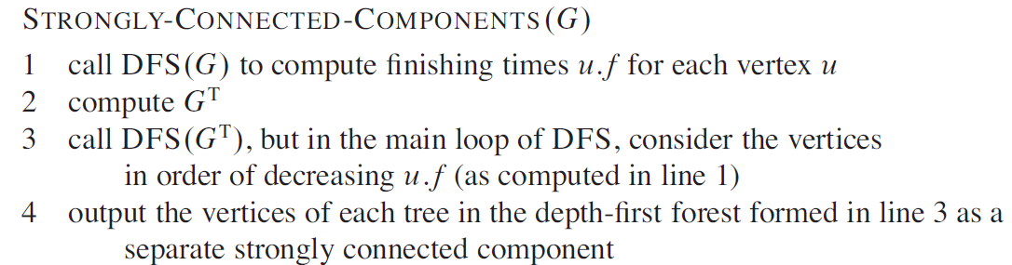
Algorithm to determine SCCs

Slide 28
Example
a
b
c
d
13/
14
11/
16
1/
10
8/
9
DFS on the initial graph G
b
16
e
15
a
14
c
10
d
9
g
7
h
6
f
4
3/
4
2/
7
5/
12/
15
6
e
f
g
h
a
b
c
d
DFS on G^{T:}
start at b: visit a, e
start at c: visit d
start at g: visit f
start at h
e
f
g
h
Strongly connected components: C₁ = {a, b, e}, C₂ = {c, d}, C₃ = {f, g}, C₄ = {h}

Slide 29
Component Graph
a
b
c
d
c d
a b e
f g
h
e
f
g
h
The component graph G^{SCC} = (V^{SCC}, E^{SCC}):
V^{SCC} = {v₁, v₂, …, v_{k}}, where v_{i} corresponds to each strongly connected component C_{i}
There is an edge (v_{i}, v_{j}) ∈ E^{SCC} if G contains a directed edge (x, y) for some x ∈ C_{i} and y ∈ C_{j}
The component graph is a DAG

Slide 30
Notations
Extend notation for d (starting time) and f (finishing time) to sets of vertices U ⊆ V:
d(U) = min_{u∈U} { d[u] } (earliest discovery time)
f(U) = max_{u∈U} { f[u] } (latest finishing time)
C₁
C₂
a
b
c
d
d(C₁)
=11
d(C₂)
=1
13/
14
11/
16
1/
10
8/
9
f(C₂)
f(C₁)
=16
=10
3/
4
2/
7
5/
12/
15
6
e
f
g
h
C₃
C₄
d(C₃)
=2
d(C₄)
=5
f(C₃)
=7
f(C₄)
=6

Slide 31
Lemma 2
Let C and C’ be distinct SCCs in a directed graph G = (V, E). If there is an edge (u, v) ∈ E, where u ∈ C and v ∈ C’ then f(C) > f(C’).
Consider C₁ and C₂, connected by edge (b, c)
C₁
C₂
a
b
c
d
d(C₁)
=11
d(C₂)
=1
13/
14
11/
16
1/
10
8/
9
f(C₂)
f(C₁)
=16
=10
3/
4
2/
7
5/
12/
15
6
e
f
g
h
C₃
C₄
d(C₃)
=2
d(C₄)
=5
f(C₃)
=7
f(C₄)
=6

Slide 32
Corollary 1
Let C and C’ be distinct SCCs in a directed graph G = (V, E). If there is an edge (u, v) ∈ E^{T}, where u ∈ C and v ∈ C’ then f(C) < f(C’).
Consider C₂ and C₁, connected by edge (c, b)
C₁ = C’
C₂ = C
Since (c, b) ∈ E^{T} ⇒ (b, c) ∈ E
From previous lemma:
f(C₁) > f(C₂)
f(C’) > f(C)
f(C) < f(C’)
a
b
c
d
e
f
g
h
C₃
C₄

Slide 33
Corollary 2
Each edge in G^{T} that goes between different components goes from a component with an earlier finish time (in the DFS) to one with a later finish time
C₁ = C’
C₂ = C
a
b
c
d
e
f
g
h
C₃
C₄

Slide 34
Why does Kosaraju’s Algorithm for SCC Work?
When we do the second DFS, on G^{T}, we start with a component C such that f(C) is maximum (b, in our case)
We start from b and visit all vertices in C₁
From corollary: f(C) > f(C’) in G for all C ≠ C’ ⇒ there are no edges from C to any other SCCs in G^{T}
⇒ DFS will visit only vertices in C₁
⇒ The depth-first tree rooted at b contains exactly the vertices of C₁
C₁
C₂
a
b
c
d
b
16
e
15
a
14
c
10
d
9
g
7
h
6
f
4
C₃
C₄
e
f
g
h

Slide 35
Why does SCC Work? (cont.)
The next root chosen in the second DFS is in SCC C₂ such that f(C) is maximum over all SCC’s other than C₁
DFS visits all vertices in C₂
the only edges out of C₂ go to C₁, which we’ve already visited
⇒ The only tree edges will be to vertices in C₂
Each time we choose a new root it can reach only:
vertices in its own component
vertices in components already visited
C₁
C₂
a
b
c
d
b
16
e
15
a
14
c
10
d
9
g
7
h
6
f
4
C₃
C₄
e
f
g
h

Slide 36
How can the number of strongly connected components of a graph change if a new edge is added?

Slide 37
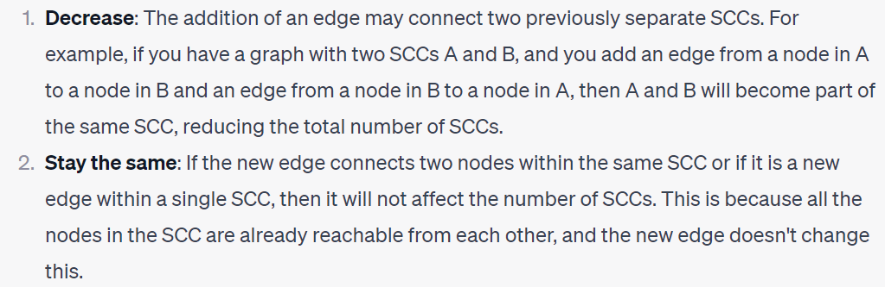
How can the number of strongly connected components of a graph change if a new edge is added?
When a new edge is added to a directed graph, the number of strongly connected components (SCCs) can either decrease or stay the same, but it cannot increase.
adding a new edge can only potentially increase the size of an existing SCC or merge separate S, but it cannot create a new SCC out of existing ones. CCs

Slide 38
Simpler method: the algorithm for strongly connected components would be simpler - if it used the original (instead of the transpose) graph in the second depth-first search - and scanned the vertices in order of increasing finishing times. Does this simpler algorithm always produce correct results?
Notes:
Decreasing finishing time order ensures we start with nodes most likely to reach others, ensuring complete SCC traversal before moving on.
A → B → C → A

Slide 39
Reference
Book: Cormen – Chapter 22 – Section 22.5
Exercise:
22.5-1: Number of componets change?
22.5-6: Minimize edge list
22.5-7: Semiconnected graph

